Slide 1
Investigating the Fermi Bubbles
By Annie Giman
Advised by Professor Rongmon Bordoloi

Slide 2
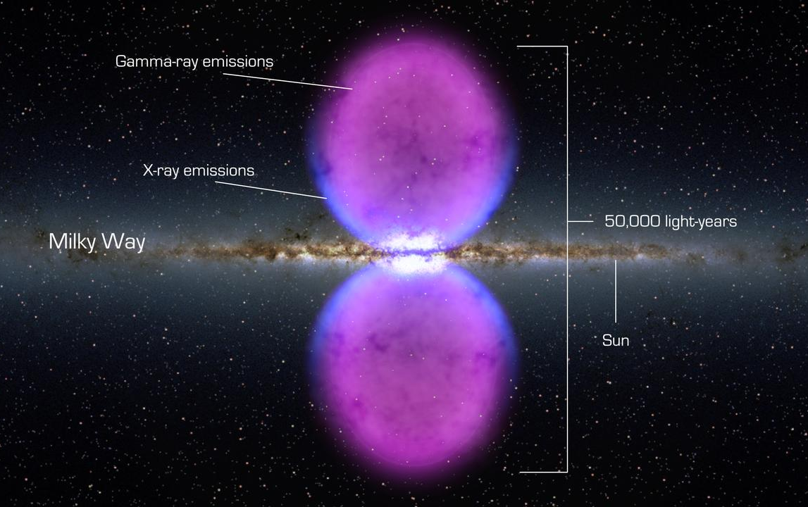
What are Fermi Bubbles?
What we know
“Bubbles” on either side of the center of our galaxy made of plasma
Doesn’t emit in the visible spectrum (so we can’t see with our eyes), but can detect other ways
Illustration: Nasa Goddard, 2017

Slide 3
What are Fermi Bubbles?
What we know
“Bubbles” on either side of the center of our galaxy made of plasma
Doesn’t emit in the visible spectrum (so we can’t see with our eyes), but can detect other ways
What we don’t know
(Almost) everything else!!!!
In particular, how old they are and how they were created
Illustration: Nasa Goddard, 2017

Slide 4
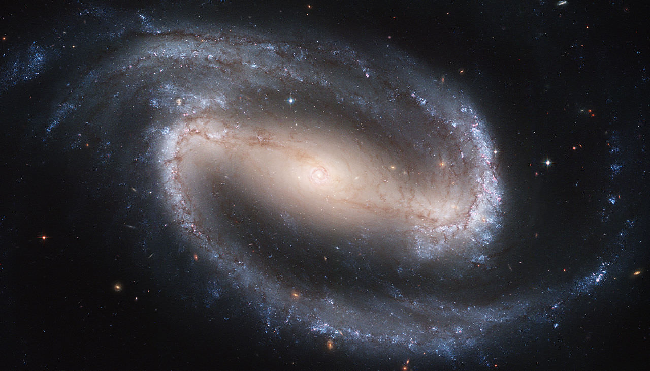
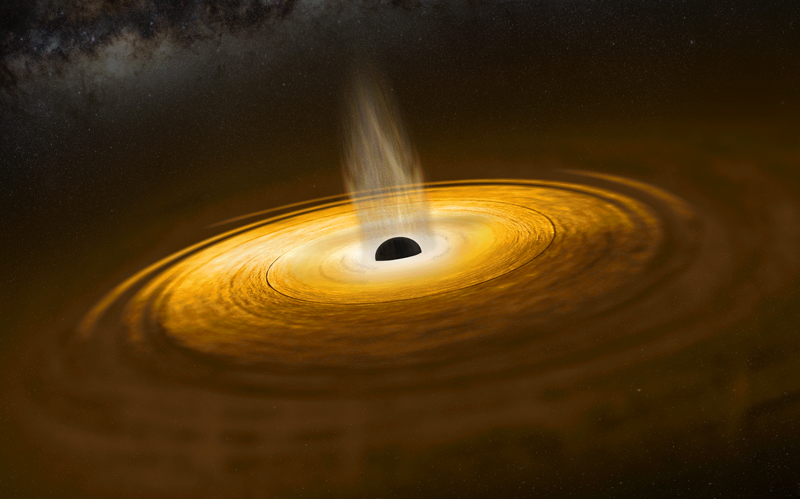
How could they have been created?
Option 1:
Star Formation Near Center
Option 2:
Black Hole “Burp”
*Not to scale, and not the Milky Way!
Illustration: European Space Agency, 2020
Photo: NGC 1300, Hubble Telescope, 2004

Slide 5
How could they have been created?
Option 2:
Black Hole “Burp”
Winner!
(We Think)
Winner!
(We Think)
…but there are a lot more questions!
Illustration: European Space Agency, 2020

Slide 6
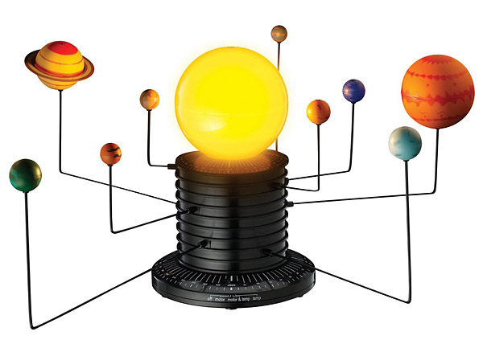
What’s a model?
Complicated things are complicated to study!
Models try to explain complicated things through simpler means
In this case:
We can’t send out a telescope far enough to see the Fermi Bubbles
We create a 3D representation of the region, so we can investigate at different points

Slide 7
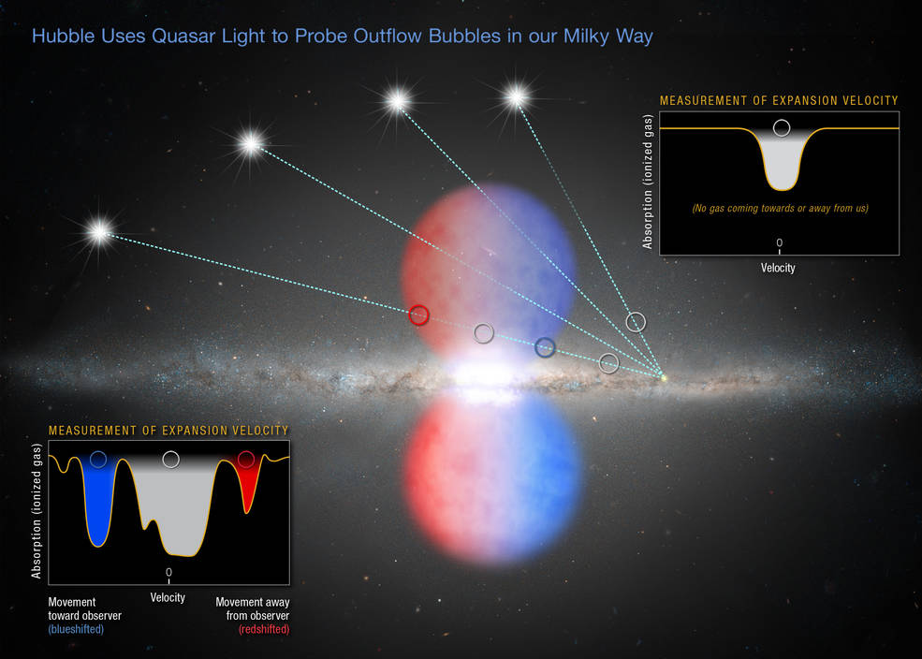
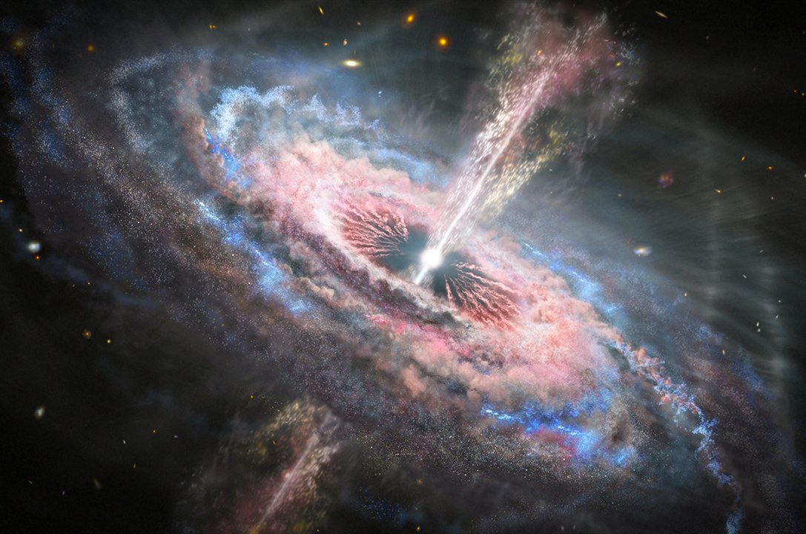
How we do it
Illustration: Joseph Olmsted for NASA, 2020
Quasar
Use light traveling from Quasars (and some stars) to “see into” the bubble
Illustration: NASA, ESA, and Z. Levy (STScI), 2017
Illustration: NASA, ESA, and Z. Levy (STScI), 2017

Slide 8
How we do it
Illustration: Joseph Olmsted for NASA, 2020
Quasar
Use light traveling from Quasars (and some stars) to “see into” the bubble
Use kinematic model (i.e. equations of motion!) to “reverse engineer” information about how the bubbles were created
Illustration: NASA, ESA, and Z. Levy (STScI), 2017

Slide 9
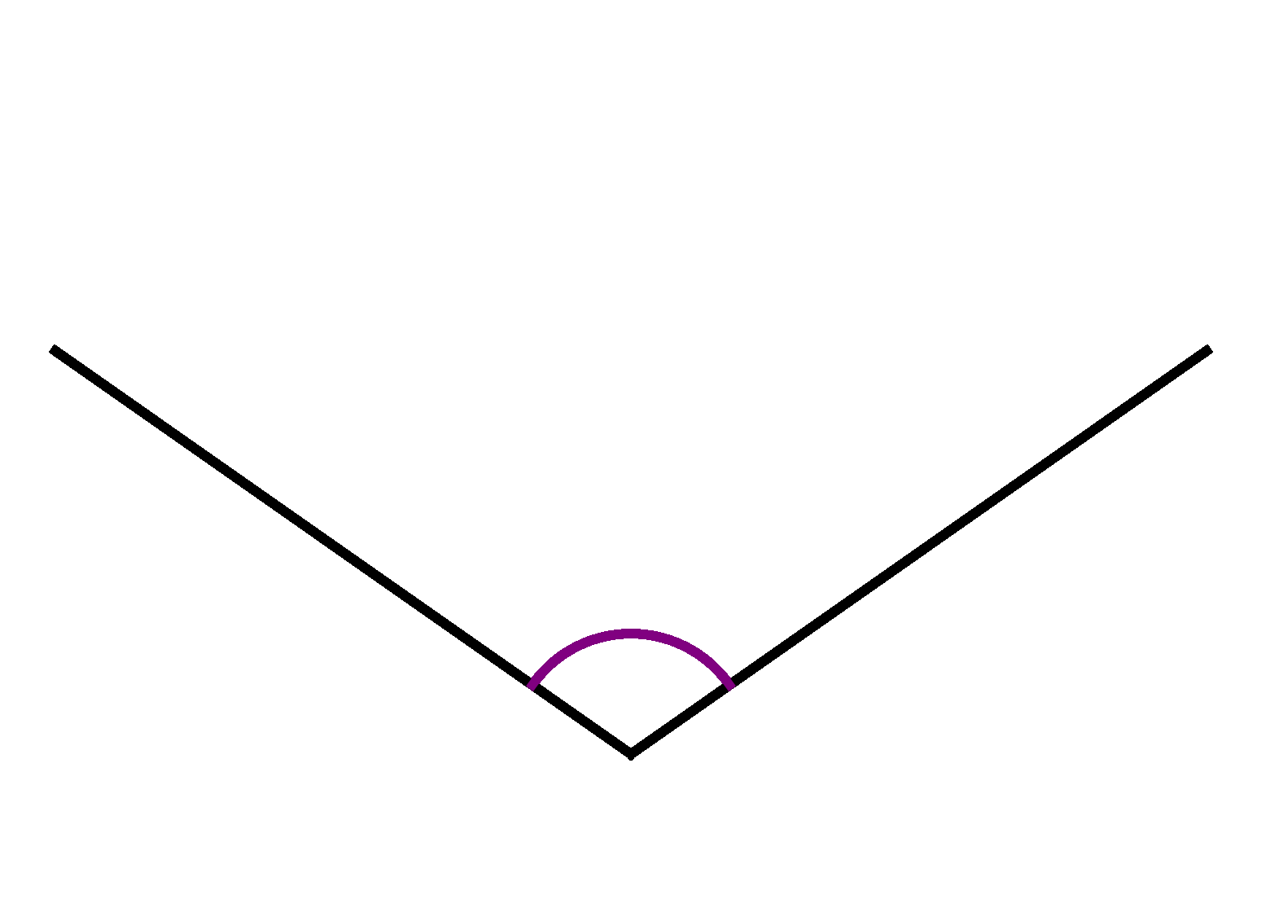
How’s it going?
We’ve successfully modeled a few sightlines!
We’ve estimated an age of around 5-6 Million Years
This sounds old but…
This is showing where we would expect stuff to be in our model, going from 1 million years to 8 million years, where each new line is 500,000 years

Slide 10
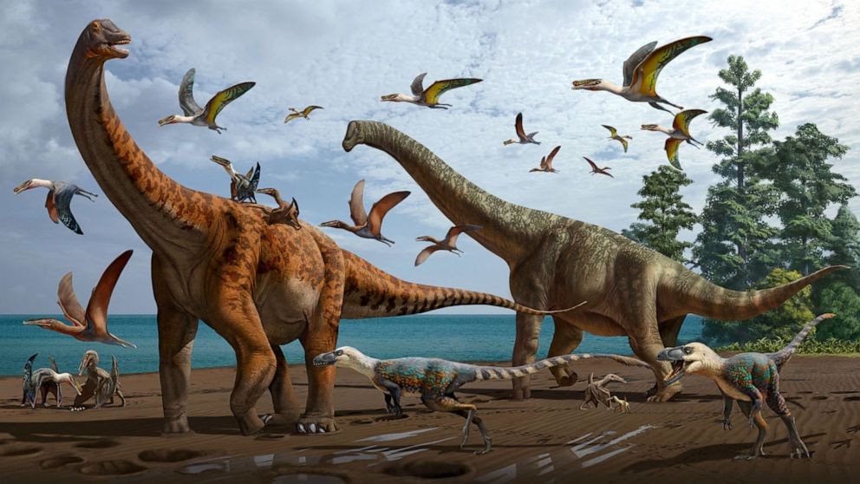
How’s it going?
We’ve successfully modeled a few sightlines!
We’ve estimated an age of around 5-6 Million Years
This sounds old but…
This is showing where we would expect stuff to be in our model, going from 1 million years to 8 million years, where each new line is 500,000 years

Slide 11
Thank you!

Slide 12
What do we want to figure out?
Working on constraining the time along many sightlines
By comparing times, we can figure out whether this kind of model fits, or if more complicated systems are required
Why do we want to figure this out?
Learn the history of our galaxy!
Figure out how supermassive black holes impact their galaxies

Slide 13
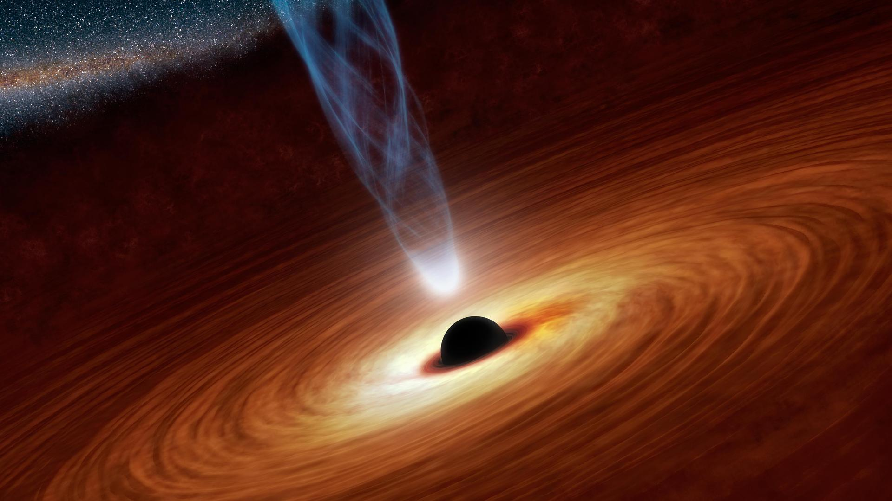
Why does this matter?
Learn the history of our galaxy!
Figure out how supermassive black holes impact their galaxiesLearn the history of our galaxy!
Figure out how supermassive black holes impact their galaxies
Illustration: NASA/JPL-Caltech, 2013

Slide 14
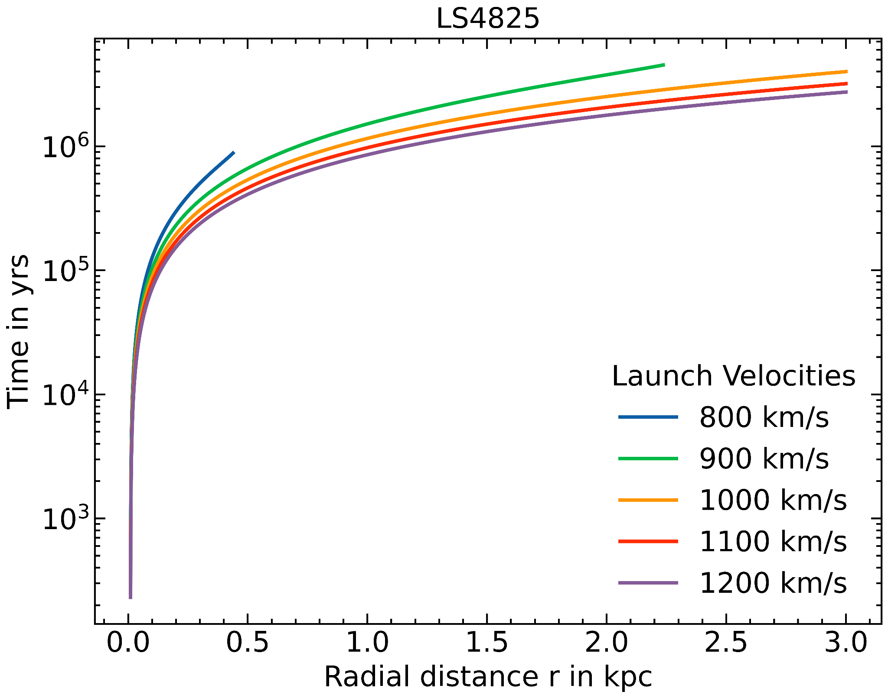
What does this look like?
We can use what we know from observations to constrain our model
Plot showing the time it would take gas to get to various radial distances for several launch velocities

Slide 15
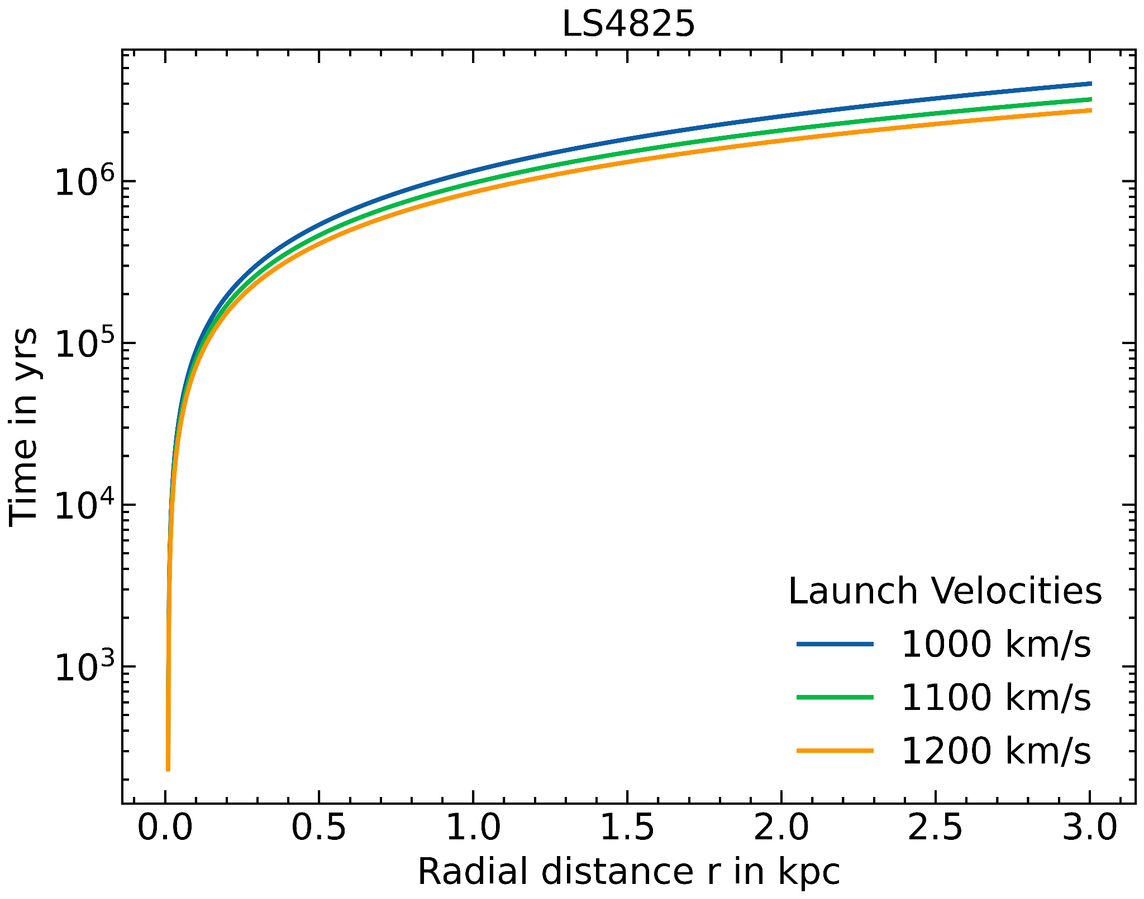
What does this look like?
We can use what we know from observations to constrain our model
Plot showing the time it would take gas to get to various radial distances for several launch velocities, constrained for v₀

Slide 16
Why does this matter?
Learn the history of our galaxy!
Figure out how supermassive black holes impact their galaxiesLearn the history of our galaxy!
Figure out how supermassive black holes impact their galaxies
Illustration: NASA/JPL-Caltech, 2013

