Slide 1
Light Curves from Core-Collapse Supernovae with Circumstellar Material
NCSU CDSA REU
Caroline Witt
Advisors: Dr. Carla Frohlich,
Dr. Sanjana Curtis
Notes:
Hello, my name is Caroline Witt. I'm from Missouri State University and this summer I'm working with Dr. Carla Frohlich and Dr. Sanjana Curtis on Light Curves from Core-Collapse Supernovae with Circumstellar Material

Slide 2
Context for Investigation
Life cycle of stars
Insights from light curves
Can help us figure out details about the progenitor star
Previous study had limitations
Treated star as if it was isolated
Credit: NASA/Chandra X-ray Center/Penn State University
Notes:
So to give some background explanation:
Stars have life cycles that they evolve through in stages.
Core-collapse supernovae are the explosion-based deaths that happen at the final stage of evolution for stars that are more than 8 times the mass of our Sun. This image shows a simple visualization of the end stages of evolution for such a star.
You can see that the star goes from being a red giant, to imploding and then having that implosion be halted and reversed into a rebound, which then sends out the shockwave and creates the supernova explosion, leaving behind a neutron star
Light curves are a plot of luminosity vs time, and they can help us figure out details about the progenitor star (which is the star that exploded into a supernova)
There was a previous study that simulated light curves from core-collapse supernova, but it's findings were restricted since the stars were treated as if they were isolated. We know that, really, stars lose mass throughout their lifetime, which ends up creating a surrounding circumstellar medium
To imploding and then having that implosion be halted and reversed into a rebound
having neutron degeneracy forcing the inner core collapse to halt

Slide 3
Goal of the Project
Build on previous study by improving accuracy of simulated environment
Implement presence of circumstellar material
Use SuperNova Explosion Code (SNEC) to obtain light curves
Compare our results against previous study to understand how the addition of circumstellar material affects resulting light curves
Notes:
So the goal of this project is to build on the previous study by adding the presence of circumstellar material in the simulations. Then, we'll run the new data through something called SuperNova Explosion Code (or SNEC) to produce the new light curves. Ultimately, we want to compare our light curves against the previous study's to try and figure out how adding the circumstellar material impacted the resulting light curve and what the differences may mean.

Slide 4
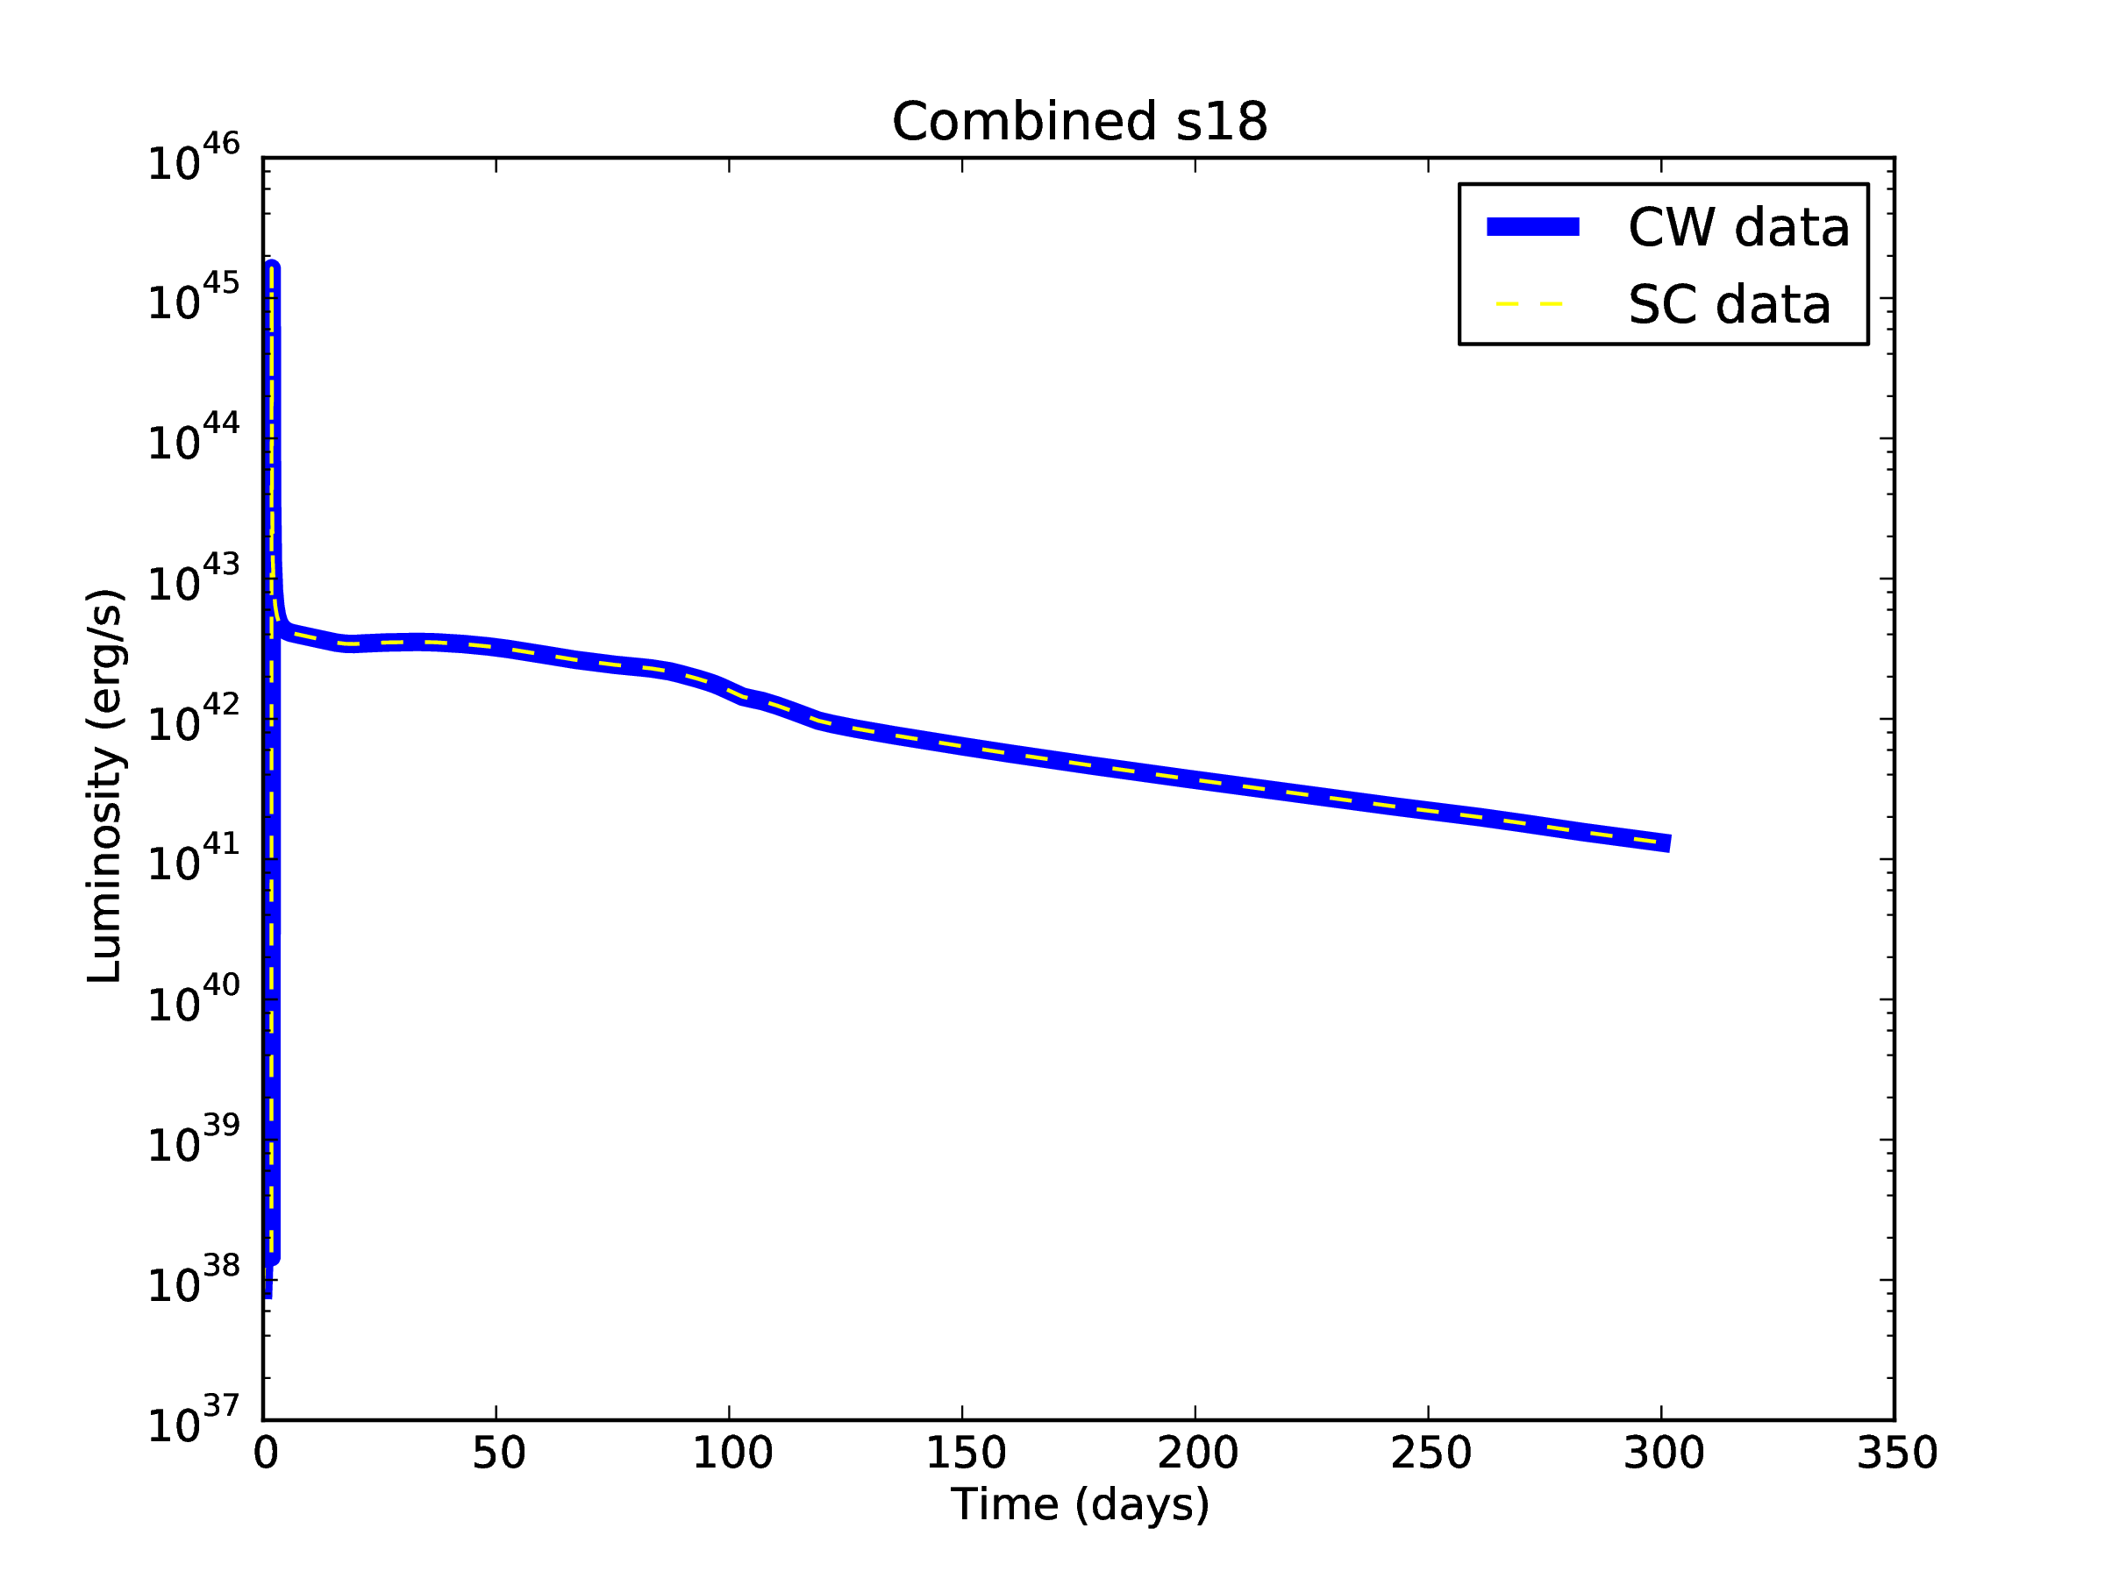
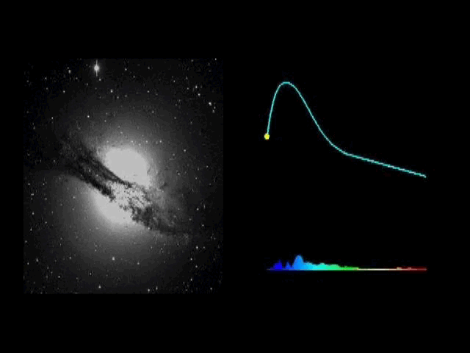
What I'm Doing
Replicated previous study's results
Currently in process of figuring out how to implement presence of circumstellar medium
Credit: Peter Nugent (Lawrence Berkeley National Laboratory), and Supernova Cosmology Project
Notes:
So, so far I have replicated the results of the previous study, just to ensure that everything is working properly. You can see a plot of my replicated light curve against the original light curve, and as you'll notice, they match perfectly, which is a good thing.
Since then, I've been working on figuring out how to actually implement the presence of the circumstellar medium into the models. There are a couple different possible methods we've come across that we're trying to work through
-Add SN images to demonstrate brightness [X]
-add observed light curve graph [X]
-define terms
-cross-check
-give image to show what circumstellar medium ----------> NO, JUST MENTION CIRCUMSTELLAR MATERIAL IS JUST MASS AND GAS LOST FROM THE STAR OVER ITS LIFETIME
-could show sun's corona to show surrounding gas

Slide 5
Next Steps
Once circumstellar medium is added, run the data through SNEC to produce light curve
Repeat process for several stars
Compare our resulting light curves against previous study's and analyze differences to determine the impact of the circumstellar material
Notes:
So after we figure out how to include the presence of the circumstellar medium, we're going to run our results through SNEC to actually get our light curves. We'll want to do this process for several stars and may end up trying a range of parameter values for each one. And then eventually, we'll work on analyzing and comparing our results and figuring out what the differences mean
Once the issue of how to include the presence of the circumstellar material is solved, we will then run the new data through SNEC to obtain our light curves. After we repeat this process for a number of stars, we will begin comparing our results against the previous study's and analyze what the differences imply.

Slide 6
Thank you for listening

