Slide 1
What Happens When a Neutron Star Orbits a Supergiant Star?
Malcolm Henderson
Advisor: John Blondin
Computational Data Science in Astrophysics Program

Slide 2
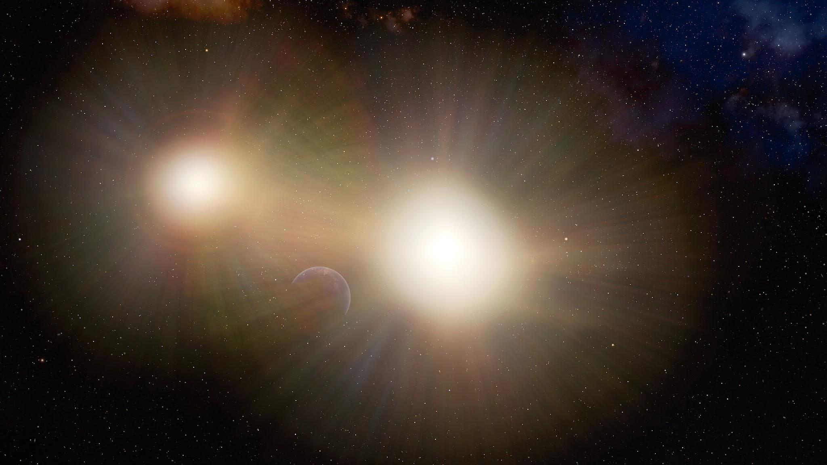
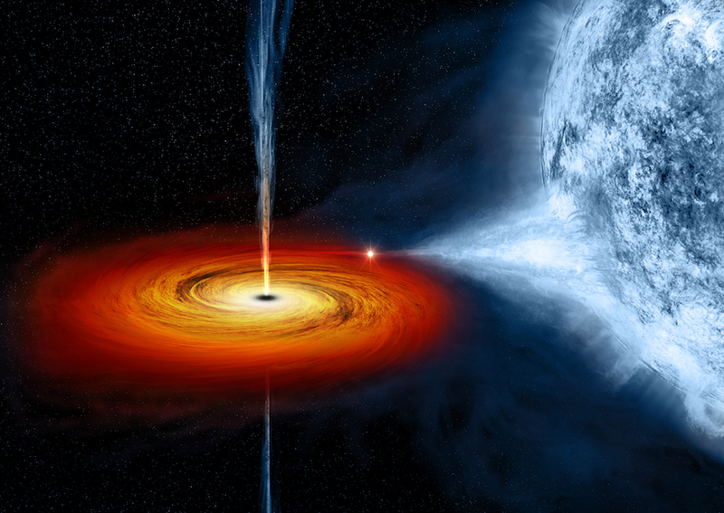
Binary Systems
Slide 1
Image credit: International Gemini Observatory/NOIRLab/NSF/AURA/J. da Silva (Illustration)
Image credit: Nasa/CXC/M. Weiss (Illustration)
Notes:
How are the X-rays produced
Define mass accretion rate and luminosity

Slide 3
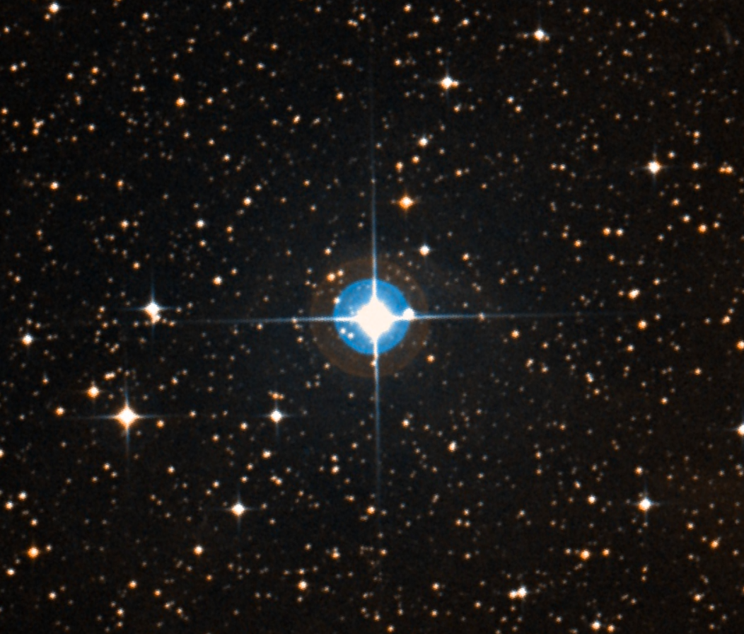
Vela X-1
Slide 2
Image credit: Digitized Sky Survey
Notes:
X-rays affect wind, wind drives the X-rays
Simplify ionization explanation
Explain the model

Slide 4
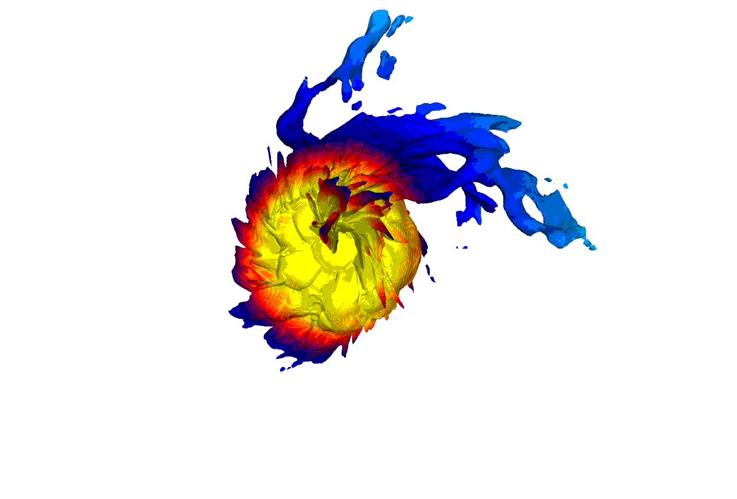
My Project
Slide 3

Slide 5
References
Image Credits:
Nasa/CXC/M. Weiss
International Gemini Observatory/NOIRLab/NSF/AURA/J. da Silva
Digitized Sky Survey
Blondin, J. M., Kallman, T. R., Fryxell,
B. A., & Taam, R. E. 1990, ApJ, 356,
591, doi: 10.1086/168865
Kretschmar, P., El Mellah, I.,
Martínez-Núñez, S., et al. 2021, A&A,
652, A95,
doi: 10.1051/0004-6361/202040272
Acknowledgements:
NSF REU program
John Blondin
FTS Team

