Slide 1
Neutrino Flavor Transformations
By Irene Silvernail and Shan Carter

Slide 2
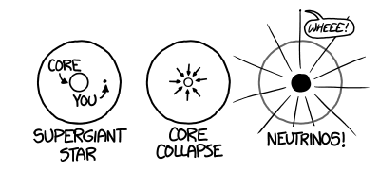
What is a supernova?
https://what-if.xkcd.com/73/
Notes:
Neutrinos are what drive the supernova explosion

Slide 3
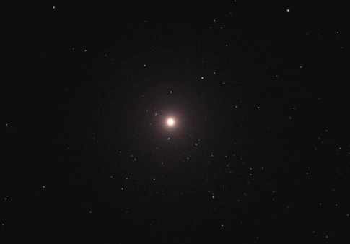
https://spaceplasma.tumblr.com/post/74724944019/supernova-explosion-artists-impression-one-of

Slide 4
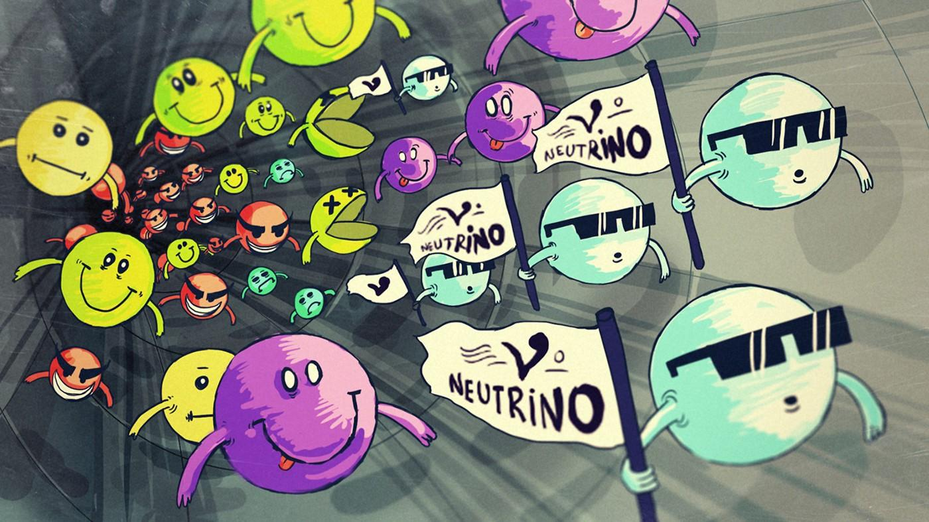
What are neutrinos?
Neutrinos are a fundamental particle, like a proton or neutron
They rarely interact with matter, however, in a supernova, interactions with matter are more frequent
https://ishwarsaini10.medium.com/hunting-neutrinos-ab57c4c7c14f
Notes:
More on flavor changing
Pictures - neutirnos are what help drive explosion
Pictures - flavor changing
Why does flavor changing matter
Caroline picture
Fundamental physics
Better understand how neutrinos work
Talk more about neutrino rarely interact with matter

Slide 5
ν_{e}
There are 3 different types of neutrinos in which we call flavors. Electron Type, muon Type and Tao Type.
Neutrinos can change from one flavor to another
ν_{μ}
ν_{τ}
https://www.vectorstock.com/royalty-free-vector/set-colorful-cartoon-ice-cream-cones-vector-36081483

Slide 6
Imagine…
ν_{e}
ν_{μ}
ν_{τ}
ν_{μ}
TRANSFORM
ν_{μ}
ν_{μ}

Slide 7
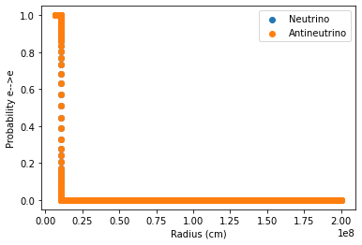
First Run
The probability that, at a given radius, an electron neutrino will stay an electron neutrino

Slide 8
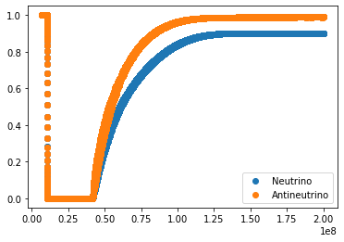
Second Run:
This also shows the probability that an electron neutrino will survive and not transform however they behaved a little differently.
Probability e—>e
Radius (cm)
Probability e—>e
Radius (cm)

Slide 9
Next Steps
Use different values for the variables
Run a more complex code that better simulates neutrino behaviors and compare those results to the simpler code we already ran

