Slide 1
Shaping a Supernova
SIERRA GENNÉ
ADVISED BY JOHN BLONDIN
COMPUTATIONAL AND DATA SCIENCE IN ASTROPHYSICS PROGRAM
NORTH CAROLINA STATE UNIVERSITY
Notes:
Name, school, studying
Advisor
Introduce topic – “I’ve been working this summer to create simulations to try to match observations of a SNR called Cassiopeia A. This would help us understand possible environments surrounding large stars when they die.”

Slide 2
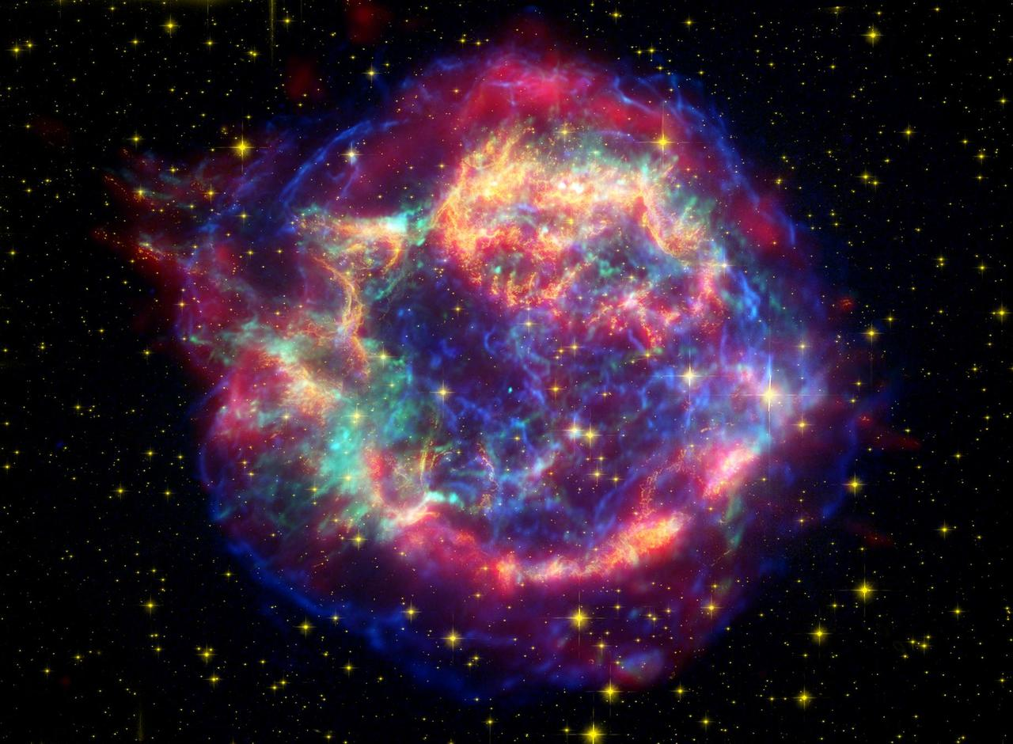
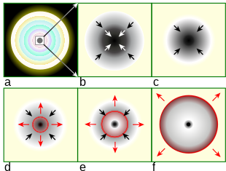
Cassiopeia A
Supernova remnant, core-collapse supernova
~330 years old
Unique shape - jets
False Color Image
By R.J. Hall - Illustration by contributor (After Modelling Supernovae with PHOENIX.), CC BY 2.5, https://commons.wikimedia.org/w/index.php?curid=1473159
images-assets.nasa.gov/image/PIA03519/PIA03519~orig.jpg
NASA/JPL-Caltech/STScI/CXC/SAO<br /> Animation: NASA/JPL-Caltech/Univ. of Ariz./STScI/CXC/SAO
Notes:
Explain that Cas A is the remains of a CC supernova
Explain how a core collapse occurs.
Define ejecta
Define SNR
Cas A is unique b/c of age and jet structures (“which are circled in white on the image shown”) which contain elements “heavier than helium”
Heavy elements pass the lighter elements during the explosion

Slide 3
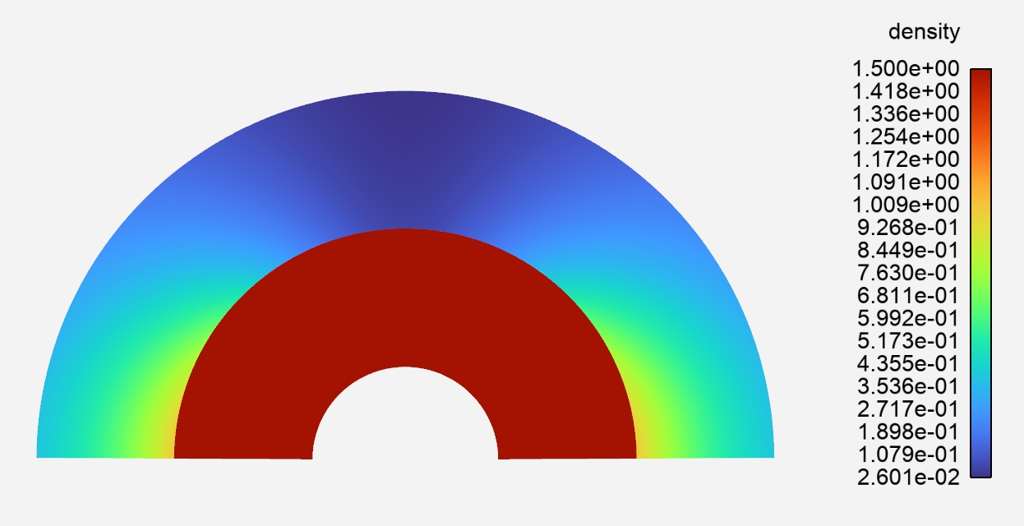
My Research
Denser around the equator
Ejecta moves faster through less dense material
The ejecta has the same density profile in all directions
Own Work
Alpha = 15.
Beta = 0.100
Own Work
Alpha = 17.
Beta = 0.010
Using a Logarithmic Ejecta Model
Using a Power Law Ejecta Model
Notes:
Explain hypothesis regarding the density profile around the star. Ejecta moves faster through lower density b/c there is less material to move out of the way.
Research that I’ve been doing: using a computer code to run simulations:
Incorporate equation to change the density around the star
65 combinations/versions, hundreds of runs
Change the way the ejecta is modeled – still symmetrical
Produced more prominent jets
Look at ratio between equator and jets to determine best candidates for values in the equation

Slide 4
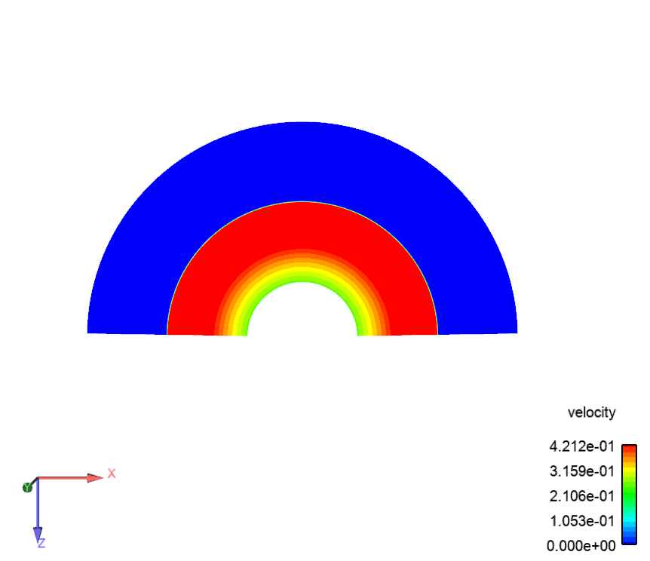
The Simulation
Own Work
Alpha = 17.
Beta = 0.010
Notes:
Example of 2D simulation.
Follows jet growth – everything is expanding outward but b/c the jet is expanding so much faster, the other areas look like they remain the same or even shrink (not accurate to reality)

Slide 5
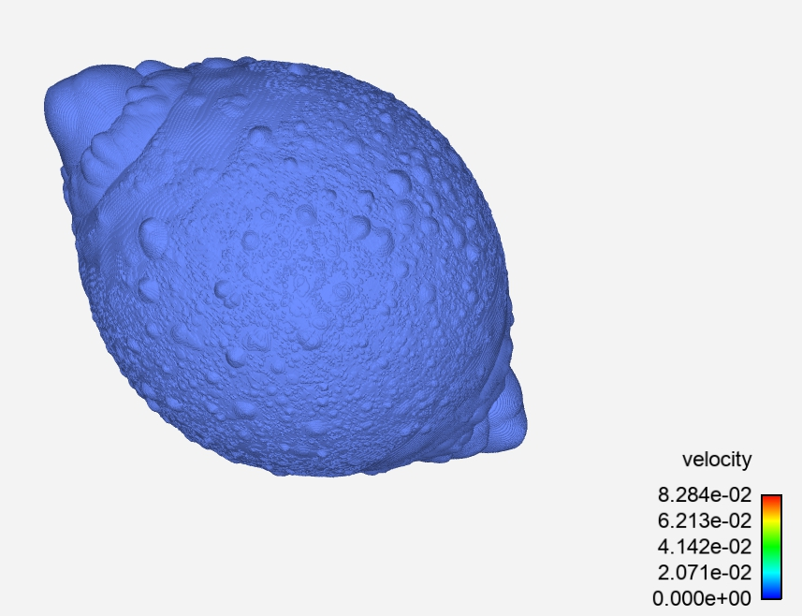
3-D Modeling & Next Steps
3-D model is the recent development
Multiple dimensions is needed
Tracking elements
Velocity of ejecta
Own Work
Alpha = 17.
Beta = 0.010
Notes:
Next steps – run a longer 3D model to produce more evolved jets
Track the movement of elements through the simulation – see if elements near the core reach the outer portions of the jets
Look at the velocity of the ejecta to better understand how it is moving
I’m optimistic!

Slide 6
Thank you!
References
Hwang, U., Laming, J. M., Badenes, C., et al. 2004, The Astrophysical Journal, 615, L117, doi: 10.1086/426186
Borkowski, K., Szymkowiak, A. E., Blondin, J. M., & Sarazin, C. L. 1996, The Astrophysical Journal, 466, 866, doi: 10.1086/177560
Acknowledgements
National Science Foundation REU Program
FTS Team
Notes:
Thank you!

