Slide 1
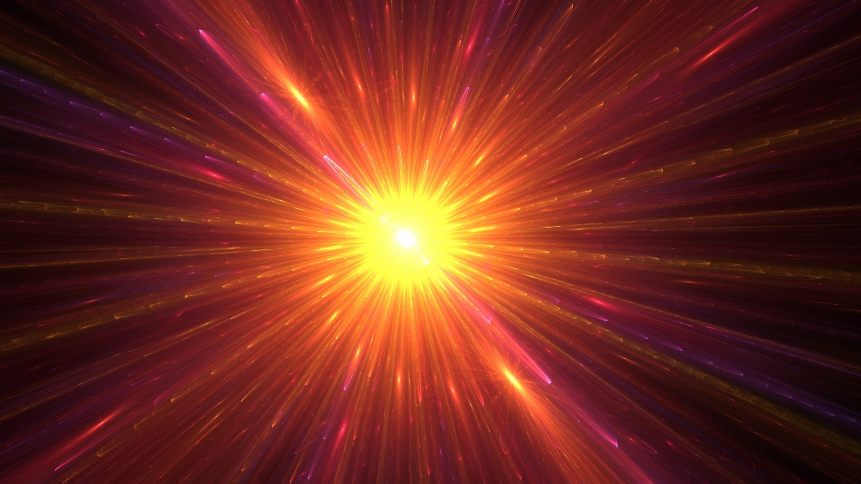


Modeling Pair Instability Supernova:
1.
from Explosion to Remnant
Zoe Rosenberg
Advisors: Dr. Carla Frohlich, Dr. John Blondin
Notes:
Hello, my name is Zoe Rosenberg, and I attend Rutgers University in New Jersey. My project is ___, and I’m working with Dr. Frohlich and Dr. Blondin
***Remember to be engaged & enthusiastic

Slide 2

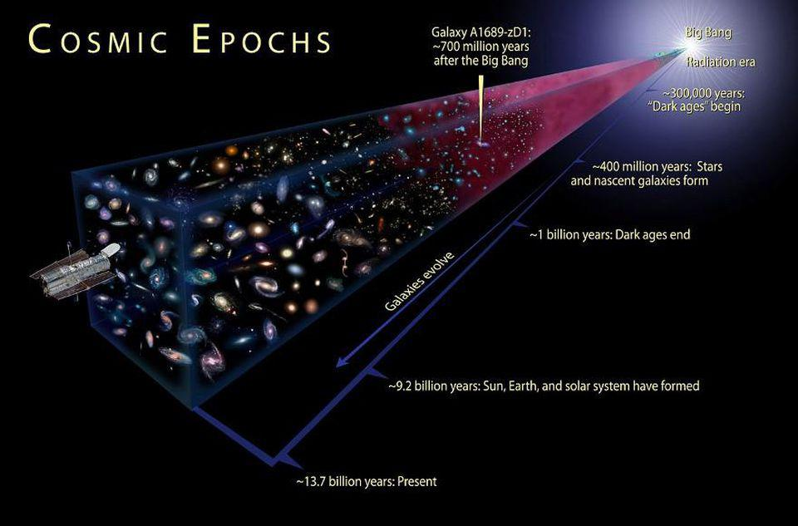
Pair Instability Supernovae (PISNe)
2.
Theorized type of stellar explosion
Progenitor (parent) stars must be:
  Very massive
  Of certain size C & O core
Occurrence in local universe?
Illustration, credit: NASA
Notes:
Mention CCSN and Thermonuclear SN, observed thru spectra and light curves
VMSs begin their lives with between 140 and 260 Msun.
C&O core size?
Clarify that the graphic shown doesn’t include PISN parent stars

Slide 3
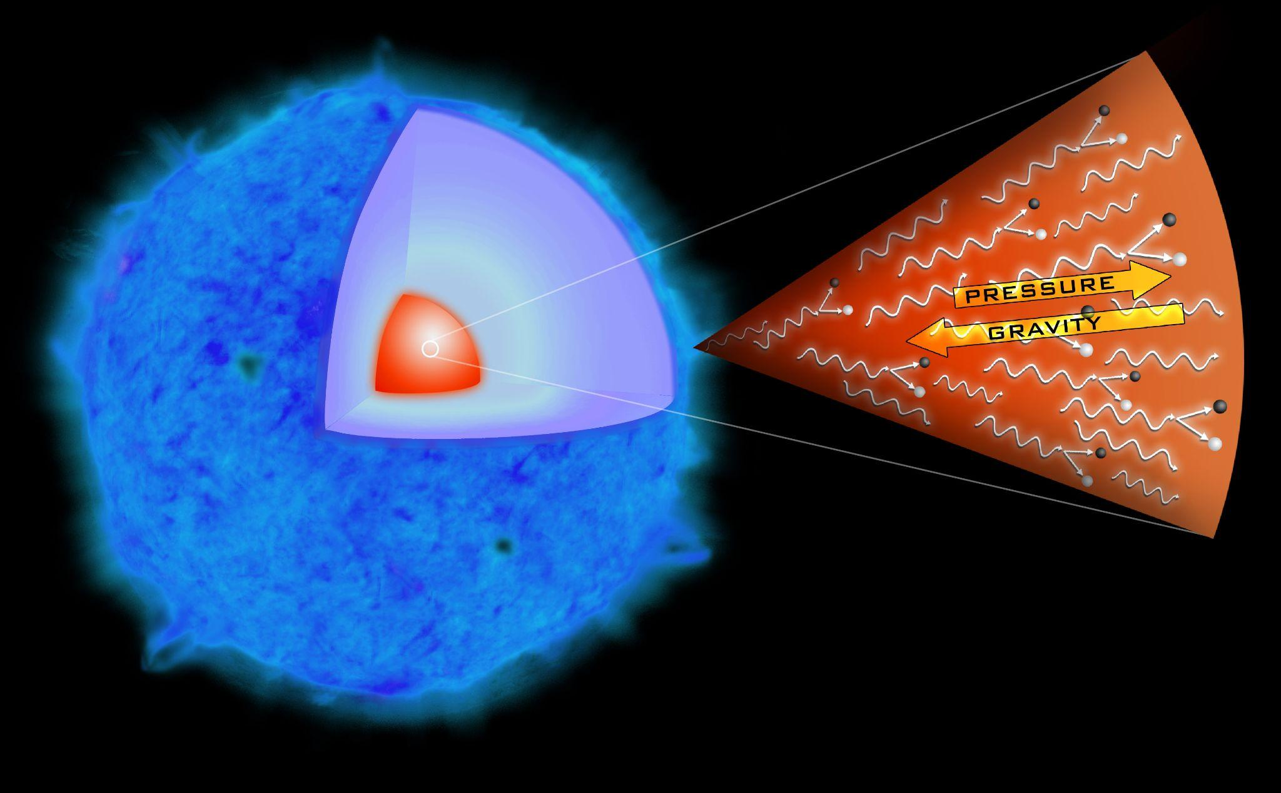
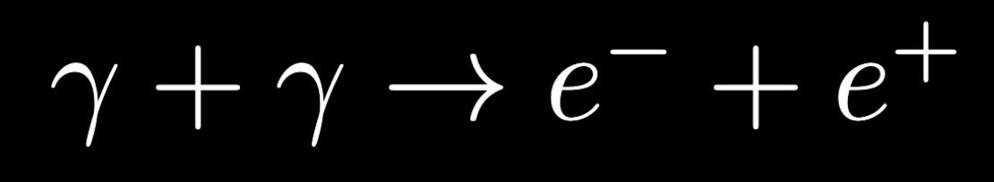
The explosion process
3.
Temperature in core becomes very high
Light particles interact
Drop in adiabatic index
Core collapses under gravity
T increases
Rapid oxygen burning
https://en.wikipedia.org/wiki/Pair-instability_supernova#/media/File:Sn2006gy_collapse_ill.jpg
Notes:
…Oxygen burning reverses the collapse and explodes the star
Image: Artist rendition re: what a PISN parent star would look like, shows where the PI process occurs (in core)

Slide 4
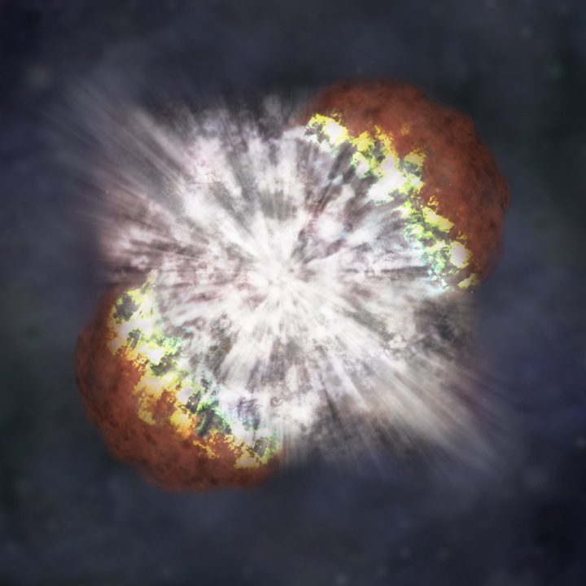
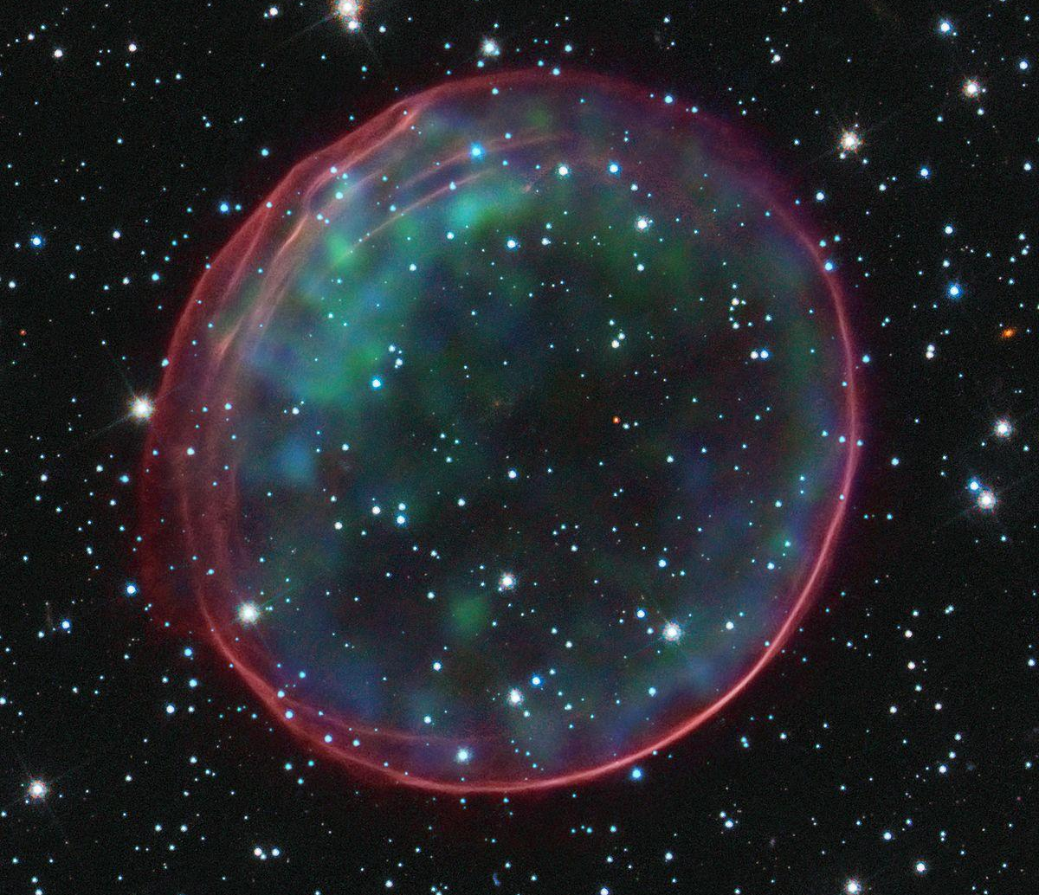
My project
4.
VH-1 → Initial conditions → evolve over time
One dimensional simulations
Three dimensional simulations
First simulation of a PISN explosion through remnant life stage
Science Credit: NASA, ESA, and B. Schaefer and A. Pagnotta (Louisiana State University, Baton Rouge) Image Credit: NASA, ESA, CXC, SAO, the Hubble Heritage Team (STScI/AURA), and J. Hughes (Rutgers University)
(Background) Illustration of a SN. Image credit: NASA/CXC/M.Weiss
r = r1
r = r2
r = r3
r1 = 1.5 billion miles
r2 = 63 billion miles
r3 = 4200 billion miles
1 hour
1 month
1 year
Notes:
Hydrodynamics→ motion of fluid (gas from explosion)
1D graphs; spherically symmetric SNR
Keep in mind that t=0 isn’t the time of the explosion, it’s a few mins after
3D can actually look at what it would look like more or less, can visually see rather than a line graph
Touch upon little drawings; can look at radius over time but also density, pressure, temperature, velocity, and location of different elements in the remnant
Excited about the project because…
Important because don’t have evidence of PISN existing, could be a step in the right direction to confirming or denying the theory. There are SNRs right now that we can’t explain, PISN explosion is one theory. If we visualize what the SNR of a PISN would look like, we could help figure out if these confusing remnants come from PISN explosions

Slide 5
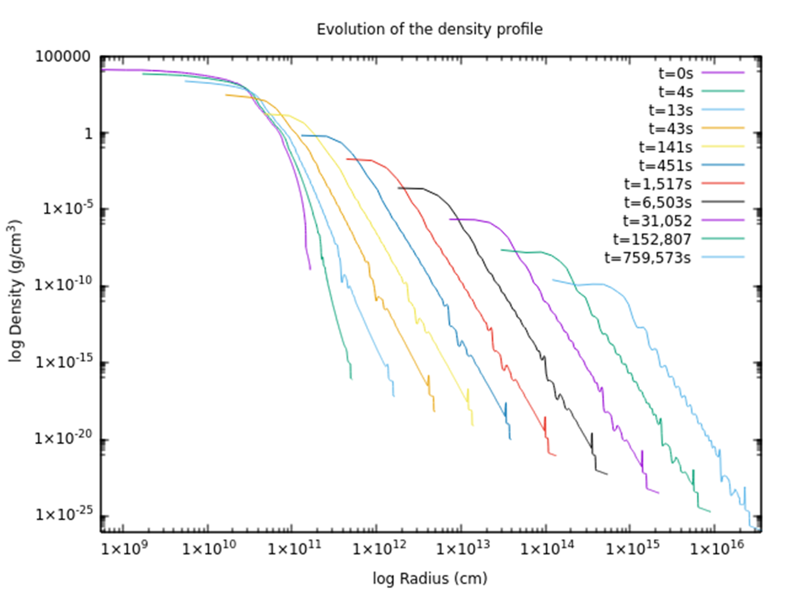
My progress
5.
Initial data from a past graduate
student (Gilmer et al. 2017)
Adding onto the VH-1 code
Graph of density profiles →
Notes:
Adding on to code: ability to track mass fractions (dist. of elements), amount of shocked ejecta
Graph: on the vertical axis it plots density, on the horizontal axis it plots radius. The “log” just means that the scale of the axes is more spread out than a typical graph’s. As you go out from the center, density starts off large and then decreases somewhat linearly (on the log log plot). This is really great because we expect actual supernova remnants to have a linear decrease on log-log plots too. The different curves correspond to values at different times in the SNR’s evolution. Once we fix numerical noise and add more to the code, we will evolve it out to a couple hundred years.

Slide 6
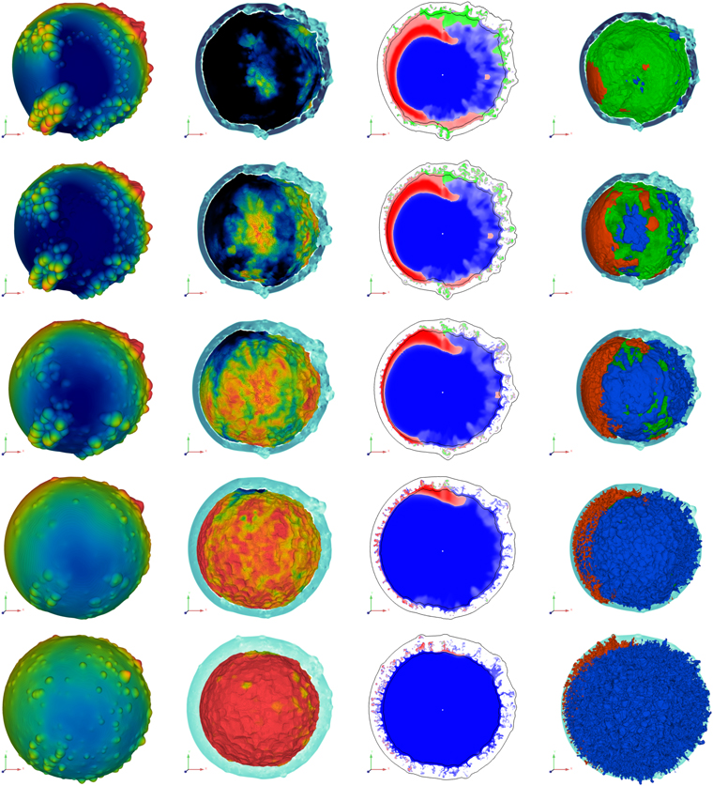
Future Work
6.
Evolve out to couple hundred years
Run similar model of “typical”
supernova
3D runs of 1D and 3D data
Comparison of 3D runs to
remnants that are PISN
candidates
Image: Stone et al. 2021
Notes:
“Typical” → thermonuclear SN that occur in the local universe
1D gives spherically symmetric remnant
This will contribute: ____
We will learn about: ____
Overall→this work will help us gain a better understanding of the processes that occur in our universe… Might be a step in the direction to potentially observe a remnant that came from PISN explosion
End with excitement too!

Slide 7


References:
7.
Barkat, Z., Rakavy, G., & Sack, N. 1967, PRL, 18, 379.
Gilmer, M. S., Kozyreva, A., Hirschi, R., et al. 2017, ApJ, 846, 100.
Kozyreva, A., Yoon, S.-C., & Langer, N. 2014, AAp, 566, A146.
Griffeth Stone, A., Johnson, H. T., Blondin, J. M., et al. 2021, ApJ, 923, 233.
Notes:
Verbally say acknowledgements

