Slide 1
Our Mission
The Physics Department faculty is committed to providing outstanding educational and research opportunities. Our highest priority is to help all students achieve their educational objectives. We serve the people of the State of North Carolina by:
providing educational opportunities to students in physics
developing world-class research programs
providing high-quality physics instruction to the University
supporting outreach activity
Search for a Department Head

Slide 2
Our vision
The Department of Physics at North Carolina State University will become a national model among public universities for its approach to and innovations in education, its excellent and diverse faculty and graduates, the significance of its research, and its contributions to other disciplines and to society in general. The Department will continue to improve its national and international stature and will be considered among the top ranked departments in the nation.
Search for a Department Head

Slide 3
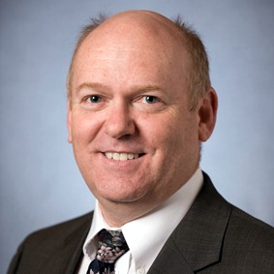
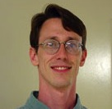
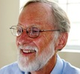
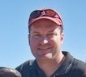
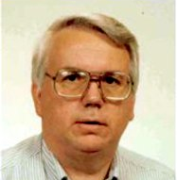
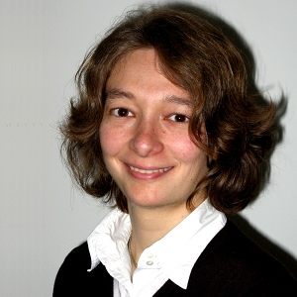
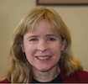
Faculty are our strength
The role of the ChairHead is to enable faculty to achieve this vision.
McGraw Prize in Education
Most read paper in Cell
Martin Teaching Award
PIRA Vice President
AVS Nerken Award
ORAU Powe Award
NSF Innovation Fellowship

Slide 4
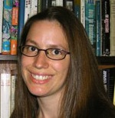
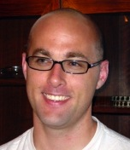
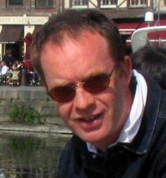
Faculty are our strength
76% of Full Professors are APS Fellows
5 of these are also ADUP
$9.6M in research funding
Outstanding junior faculty
NSF
Career
Awards
Thin Fluids Day
Prompt GRB Conference
Center for Molecular Spintronics

Slide 5
Duties of the ChairHead
Governance
committees, faculty meetings, rules, procedures, votes
Operations
teaching/service assignments, resource allocation, HR
Advancement
representing and promoting department on/off campus
Strategic Planning
coordinate long-range planning

Slide 6
Responsibilities of the ChairHead
Get the right people
Demand success, early assessment, enthusiastic support
Motivate to excel, cultivate collegiality
respecting each other's abilities to contribute to Mission
Confront brutal facts
improvement in the face of limited resources
Stimulate continual progress
Assess and respond, shifting limited resources

Slide 7
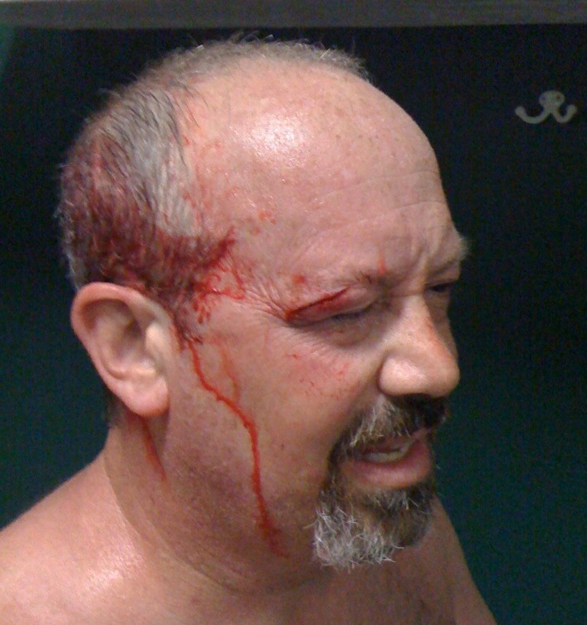
Leadership by the ChairHead
Legislative vs Executive
blend of both
Listen carefully to all viewpoints
(NOT) Consensus-building
Make right decisions and follow through
avoid mid-course corrections, backtracking
Promote faculty
fight and cheer

Slide 8
What do I bring to the table?
Balanced viewpoint
research, teaching, outreach

Slide 9
Research

Slide 10
Research

Slide 11
Research

Slide 12
Research

Slide 13
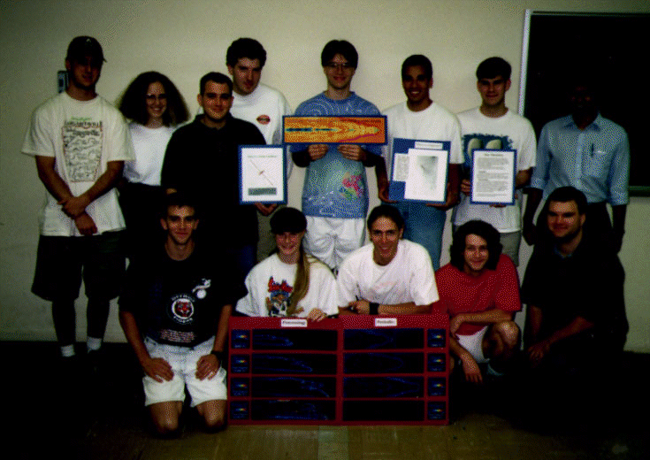
Teaching
123, 201, 203, 205, 208, 299, 328, 411, 412, 414, 415, 512
Integrated Research into the Classroom (PY 328: 95, 97, 02)
Developed introductory computational physics course
Outstanding Teacher Award (2000)
Alumni Distinguished Undergraduate Professor (2010)

Slide 14
Outreach
Astronomy night at CCMS
Family Science Night at Washington
Astronomy Days at NC Museum
SPS Physics Demonstrations at WCPS
Science Café, Duke TIP, NCSSM…

Slide 15
What do I bring to the table?
Balanced viewpoint
research, teaching, outreach
Will to improve
assess → plan → implement

Slide 16
Always room for improvement
“The moment you think of yourself as great, your slide to mediocrity has already begun.”
My approach to the Undergraduate Physics Program is to continuously ask “how can we improve?”
Assess: exit interviews, faculty feedback, grades
Identify: junior wall, senior lab, computing, math
Solve: move PY411, sophomore lab, FAQ page, newsletter, programming, alumni dinner, …

Slide 17
What do I bring to the table?
Balanced viewpoint
research, teaching, outreach
Will to improve
assess → plan → implement
Strong service record
Department, University, Science Community

Slide 18
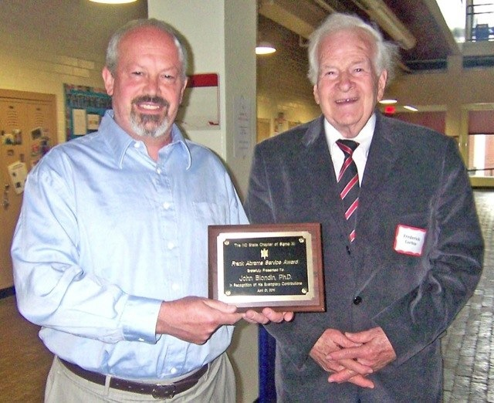
Service
Department of Physics
As Assistant Prof. created first PY website and Physics Honors Program. SPS advisor, Sigma Pi Sigma advisor, DUP since 2007, Committees: Advisory, Computer, Personnel, Course and Curriculum, CRC, RPT, Space, Colloquium
NC State University
University Honors Council, University Research Committee, University HPC Committee, Provost’s IT Scoping Committee, Goldwater Selection, PAMS Honors, PAMS HPC, Undergraduate Research Awards/Symposia
Science Community
NASA/NSF/DOE program reviews, Hosted AAS meeting (1997) and AIP SPIN-UP Workshop (2009), CiSE Editorial Board, Teragrid Allocations

Slide 19
chairheadchairheadchairheadchair
MEAS: New Head and Associate Head
Math: Head and Associate Head work collaboratively; active advisory committee
Statistics: Department Head and 5 Directors
Chemistry: Chair (3yr term), Associate Chair (appointed by Chair, currently a TAP), no Executive Officer nor Director of Facilities

Slide 20
chairheadchairheadchairheadchair
The Physics Department has (had)
A strong administrative infrastructure
An advisory committee
An Associate Department Head
Head > Chair is about defining rotation

Slide 21
chairheadchairheadchairheadchair
If chosen, I will…
Continue active (?) research program
Expect to step down in 3-5 years
Direct the rewriting of bylaws
head → chair

Slide 22
Hot-Button Issues
Physics Education Research
PY 205 / PY 208
Limited Resources (Space)
Teaching Load
Support Personnel

