Slide 1
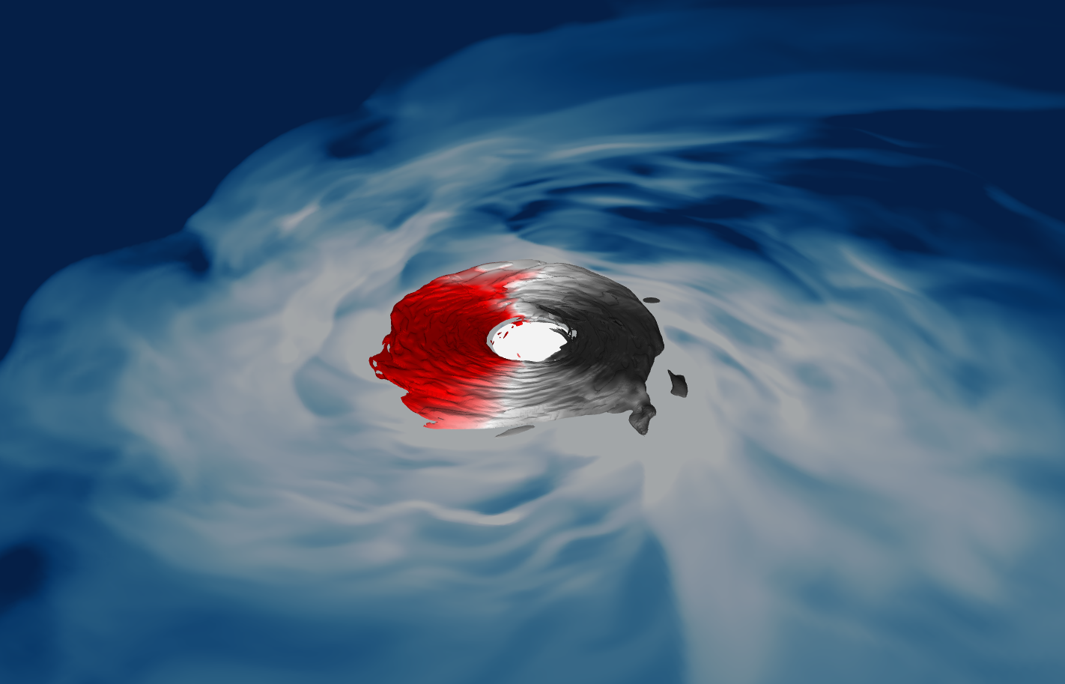
Capturing the Accretion
in
Accreting
Compact Binaries

Slide 2
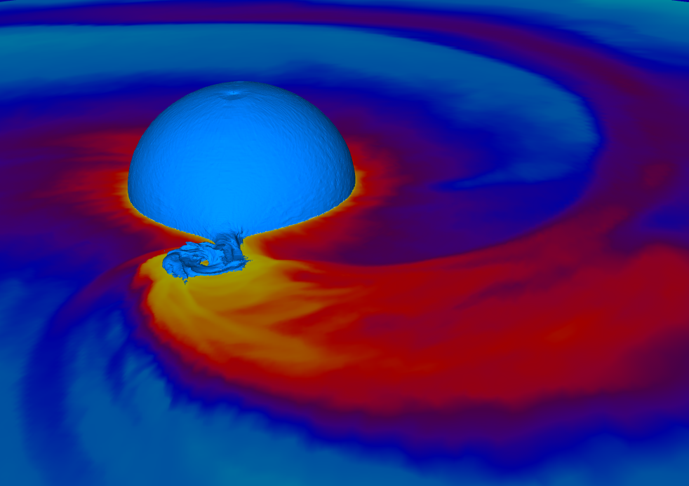
2015
Moved 1990’s 2D model to 3D
Axis artifacts
Limited resolution
Ang mom loss

Slide 3
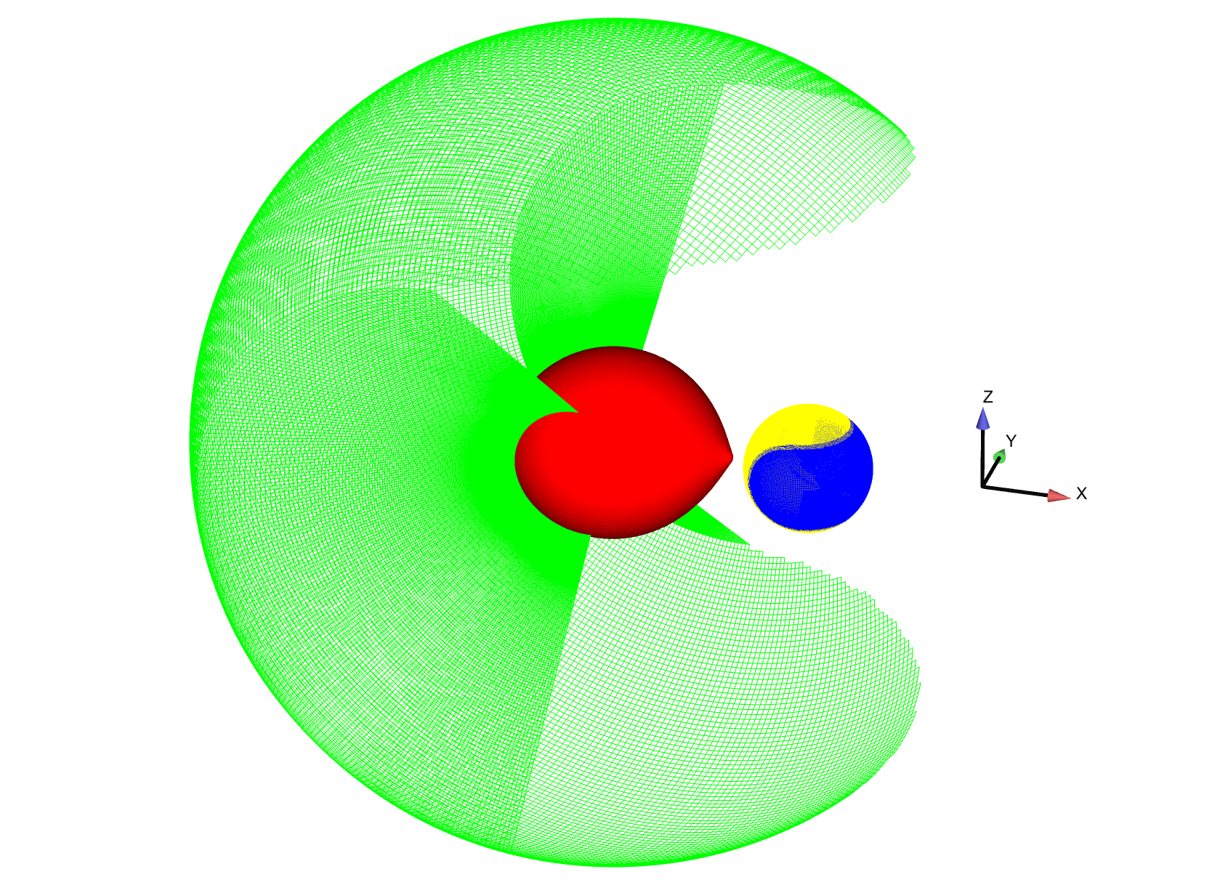
2021
Yin Yang grid
Explicit conservation of J
Nested grids

Slide 4
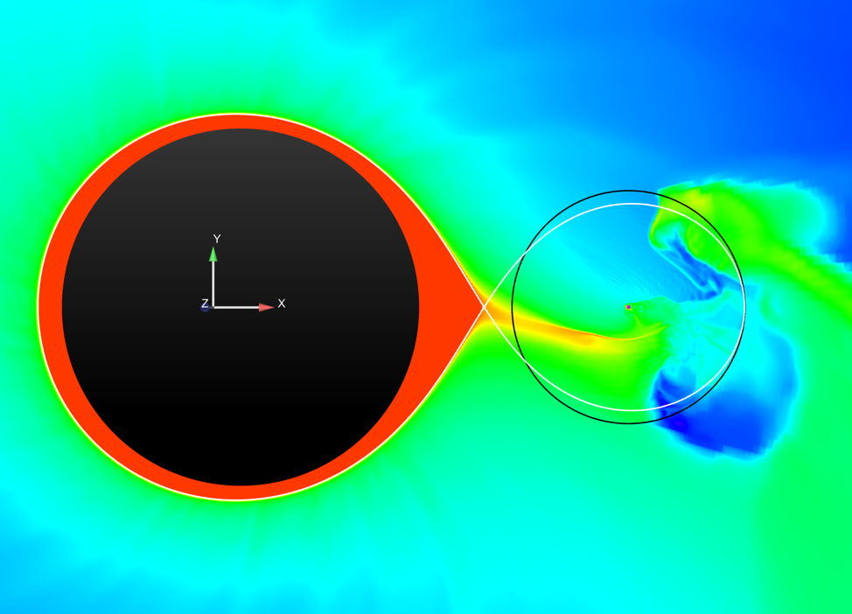

Slide 5
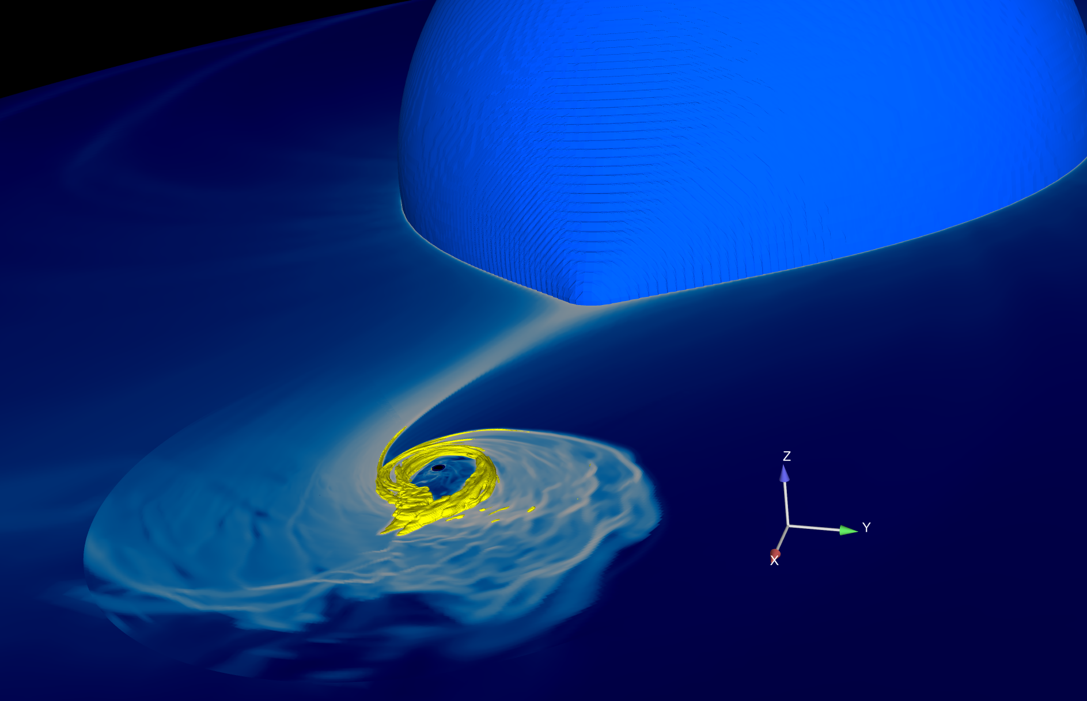
M33 X-7

